Slide 1

Chapter
3
© 2007 Prentice Hall, Inc.
All rights reserved.

Slide 2
L E A R N I N G O U T L I N E
Follow this Learning Outline as you read and study this chapter.
The Manager: Omnipotent or Symbolic
  Contrast the action of manager according to the omnipotent and symbolic views.
  Explain the parameters of managerial discretion.
The Organization’s Culture
  Describe the seven dimensions of organizational culture.
  Discuss the impact of a strong culture on organizations and managers.
  Explain the source of an organization’s culture.
  Describe how culture is transmitted to employees.
  Describe how culture affects managers.
© 2007 Prentice Hall, Inc. All rights reserved.
3–<number>

Slide 3
L E A R N I N G O U T L I N E (cont’d)
Follow this Learning Outline as you read and study this chapter.
Current Organizational Cultural Issues Facing Managers
  Describe the characteristics of an ethical culture, an innovative culture, and a customer-responsive culture.
  Discuss why workplace spirituality seems to be an important concern.
  Describe the characteristics of a spiritual organization.
© 2007 Prentice Hall, Inc. All rights reserved.
3–<number>

Slide 4
L E A R N I N G O U T L I N E (cont’d)
Follow this Learning Outline as you read and study this chapter.
The Environment (cont’d)
  Describe the components of the specific and general environments.
  Discuss the two dimensions of environmental uncertainty.
  Identify the most common organizational stakeholders.
  Explain the four steps in managing external stakeholder relationships.
© 2007 Prentice Hall, Inc. All rights reserved.
3–<number>

Slide 5
Reading an Organization’s
Culture: Find One Where You’ll
Be Happy
🧠 Why Is This Important?
If the culture fits you, you’re more likely to:
Enjoy your job
Stay longer
Do better work
Get along with your team
Feel motivated and comfortable
© 2007 Prentice Hall, Inc. All rights reserved.
1–<number>

Slide 6

How Can You “Read” Organization Culture?
1. Do background work.
2. Observe the physical surroundings and corporate symbols.
3. How would you characterize the people you
meet?
4. Look at the organization’s HR manual.
5. Ask questions of the people you meet.
© 2007 Prentice Hall, Inc. All rights reserved.
1–<number>

Slide 7

The Manager: Omnipotent or Symbolic?
Omnipotent View of Management
  Managers are directly responsible for an organization’s success or failure.
  The quality of the organization is determined by the quality of its managers.
  Managers are held accountable
  for an organization’s performance
  yet it is difficult to attribute
  good or poor performance
  directly to their influence
  on the organization.
© 2007 Prentice Hall, Inc. All rights reserved.
3–<number>

Slide 8

The Manager: Omnipotent or Symbolic?
Symbolic View of Management
  Much of an organization’s success or failure is due to external forces outside of managers’ control.
  The ability of managers to affect outcomes is influenced and constrained by external factors.
    The economy, customers, governmental policies, competitors, industry conditions,
    technology, and the actions of
    previous managers
  Managers symbolize control and
  influence through their action.
© 2007 Prentice Hall, Inc. All rights reserved.
3–<number>

Slide 9
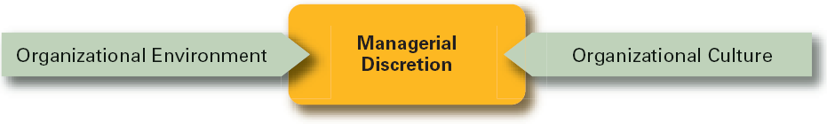
Exhibit 3–1 Parameters of Managerial Discretion
© 2007 Prentice Hall, Inc. All rights reserved.
3–<number>

Slide 10
Defining the External Environment
External Environment
  Those factors and forces outside the organization that affect the organization’s performance.
Components of the External Environment
  Specific environment: external forces that have a direct and immediate impact on the organization.
  General environment: broad economic, socio-cultural, political/legal, demographic, technological, and global conditions that may affect the organization.
© 2007 Prentice Hall, Inc. All rights reserved.
3–<number>

Slide 11
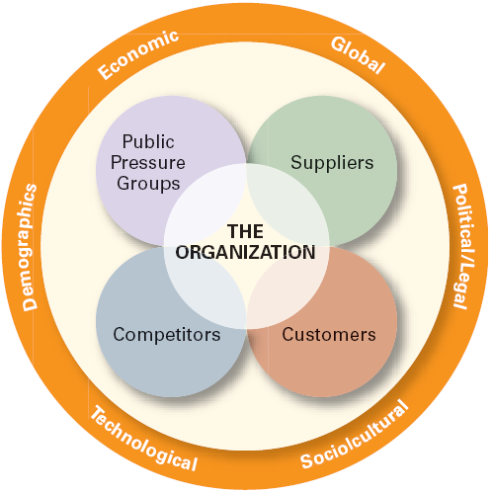
Exhibit 3–9 The External Environment
© 2007 Prentice Hall, Inc. All rights reserved.
3–<number>

Slide 12
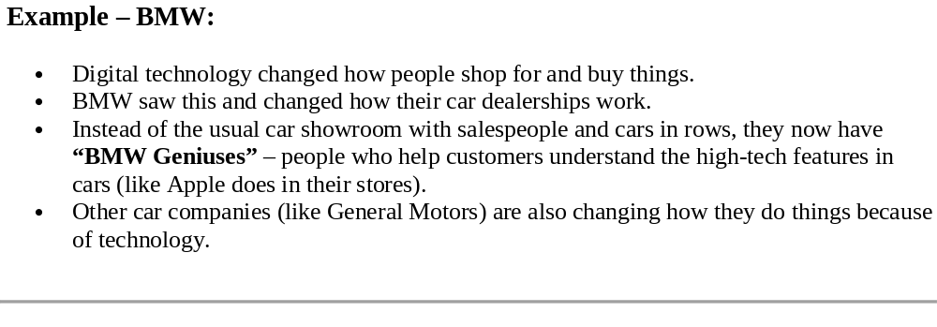
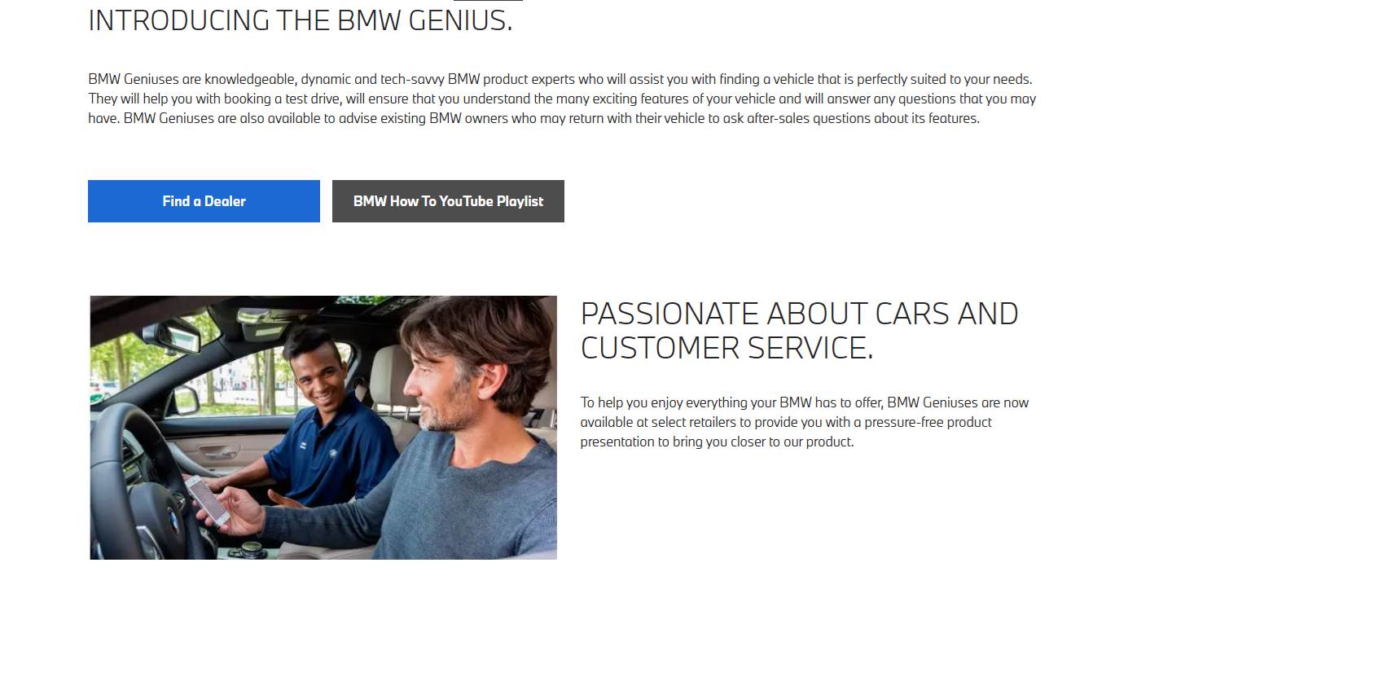
© 2007 Prentice Hall, Inc. All rights reserved.
1–<number>

Slide 13
How the Environment Affects Managers
Environmental Uncertainty
What Is Environmental Uncertainty?
Environmental uncertainty refers to how much and how quickly things change in the external environment of an organization and how complex those external elements are.
The matrix in Exhibit 3–11 helps managers understand the environment they are operating in using two dimensions:
Degree of Change
Stable: Predictable, slow or no change.
Dynamic: Unpredictable, frequent and rapid change.
Degree of Complexity
Simple: Few components (e.g., few competitors, suppliers, or stakeholders).
Complex: Many components, often very different and requiring specialized knowledge.
© 2007 Prentice Hall, Inc. All rights reserved.
3–<number>

Slide 14
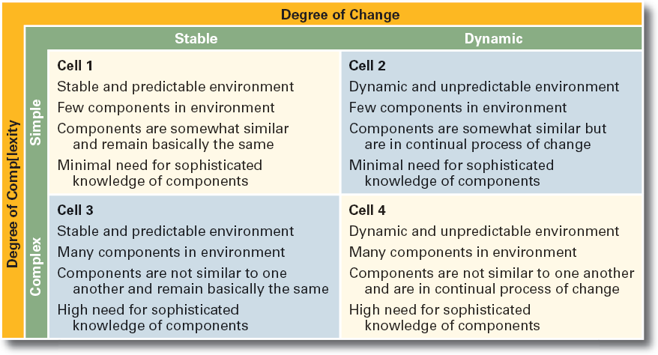
Exhibit 3–11 Environmental Uncertainty Matrix
© 2007 Prentice Hall, Inc. All rights reserved.
3–<number>

Slide 15
.
Cell | Environment | Change | Complexity | Manager Needs
1 | Simple + Stable | Low | Low | Easy to manage
2 | Simple + Dynamic | High | Low | Some flexibility needed
3 | Complex + Stable | Low | High | Needs expert knowledge
4 | Complex + Dynamic | High | High | Very challenging; needs strong management skills
📈 Why This Matrix Matters
Managers use this matrix to:
Assess risks in their environment.
Decide how flexible or structured their organization needs to be.
Adapt their strategy to the level of uncertainty.
🔹 Cell 1: You can plan long-term and standardize processes.
🔹 Cell 4: You need agility, constant market scanning, and innovation.
© 2007 Prentice Hall, Inc. All rights reserved.
1–<number>

Slide 16
👥 Who Are Stakeholders?
  Stakeholders
  Any constituencies in the organization’s environment that are affected by the organization’s decisions and actions
  What Does It Mean?
  Stakeholders are people or groups affected by what a business does — and they can also affect the business in return.
  Inside or Close to the Organization:
  Employees: People who work for the company.
  Unions: Groups that represent employees to protect their rights.
  Shareholders: People or companies that own part of the business.
  Suppliers: Businesses that provide the materials or products needed.
  Customers: People who buy the products or services.
© 2007 Prentice Hall, Inc. All rights reserved.
3–<number>

Slide 17
Stakeholder Relationships 🤝
  Managing relationships with these stakeholders is a key job for managers, because strong relationships = better results
  Why Manage Stakeholder Relationships?
  It can lead to improved organizational performance.
  They can support or harm the business, so managers must work with them.
© 2007 Prentice Hall, Inc. All rights reserved.
1–<number>

Slide 18
🎬 Example: YouTube
YouTube became successful because it built good relationships with its stakeholders:
  Viewers (people who watch videos)
  Content creators (celebrities, influencers, everyday people)
  Public service groups (e.g., for educational or social awareness content)
By keeping these groups happy, YouTube has grown into one of the biggest media platforms.
© 2007 Prentice Hall, Inc. All rights reserved.
1–<number>

Slide 19
Managing Stakeholder Relationships
Identify the organization’s external stakeholders.
Determine the particular interests and concerns of the external stakeholders.
Decide how critical each external stakeholder is to the organization.
Determine how to manage each individual external stakeholder relationship.
© 2007 Prentice Hall, Inc. All rights reserved.
3–<number>

Slide 20
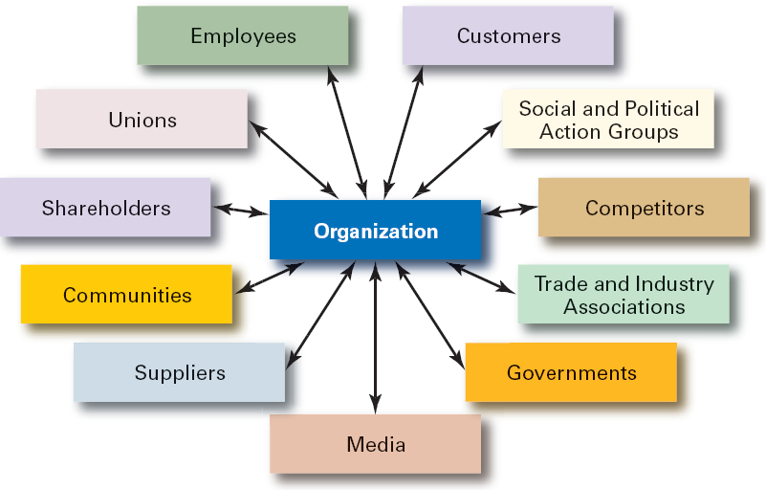
Exhibit 3–12 Organizational Stakeholders
© 2007 Prentice Hall, Inc. All rights reserved.
3–<number>

Slide 21

The Organization’s Culture
Organizational Culture
  A system of shared meanings and common beliefs held by organizational members that determines, in a large degree, how they act towards each other.
  “The way we do things around here.”
    Values, symbols, rituals, myths, and practices
  Implications:
    Culture is a perception.
    Culture is shared.
    Culture is descriptive.
© 2007 Prentice Hall, Inc. All rights reserved.
3–<number>

Slide 22
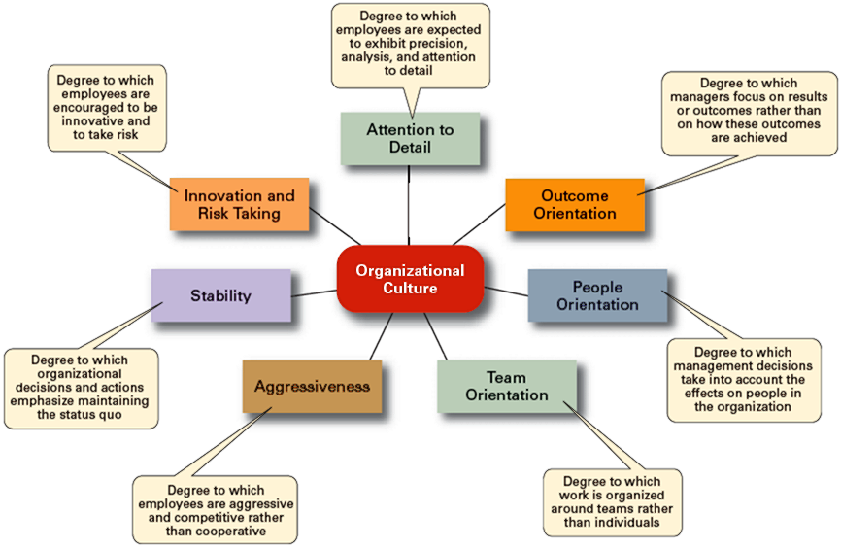
Exhibit 3–2 Dimensions of Organizational Culture
© 2007 Prentice Hall, Inc. All rights reserved.
3–<number>

Slide 23
Strong versus Weak Cultures
Strong Cultures
  Are cultures in which key values are deeply held and widely held.
  Have a strong influence on organizational members.
Factors Influencing the Strength of Culture
  Size of the organization
  Age of the organization
  Rate of employee turnover
  Strength of the original culture
  Clarity of cultural values and beliefs
© 2007 Prentice Hall, Inc. All rights reserved.
3–<number>

Slide 24

Benefits of a Strong Culture
Creates a stronger employee commitment to the organization.
Aids in the recruitment and socialization of new employees.
Fosters higher organizational
performance by instilling and
promoting employee initiative.
© 2007 Prentice Hall, Inc. All rights reserved.
3–<number>

Slide 25
Organizational Culture
Sources of Organizational Culture
  The organization’s founder
    Vision and mission
  Past practices of the organization
    The way things have been done
  The behavior of top management
Continuation of the Organizational Culture
  Recruitment of like-minded employees who “fit”
  Socialization of new employees to help them adapt to the culture
© 2007 Prentice Hall, Inc. All rights reserved.
3–<number>

Slide 26
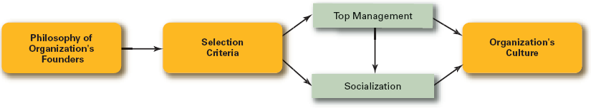
Exhibit 3–5 How an Organization’s Culture Is Established and Maintained
© 2007 Prentice Hall, Inc. All rights reserved.
3–<number>

Slide 27
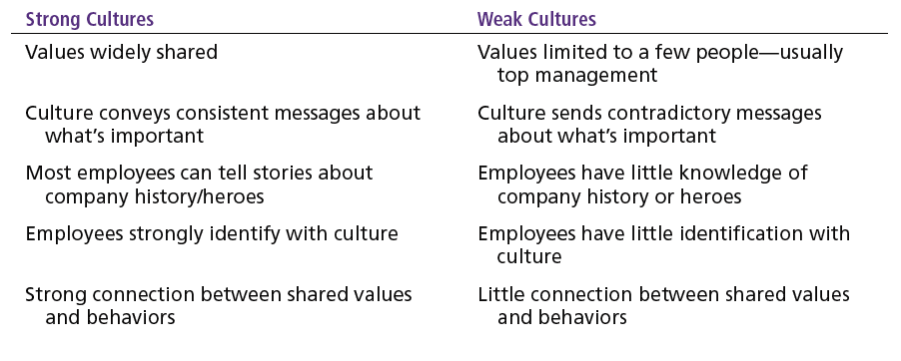
Exhibit 3–4 Strong versus Weak Organizational Cultures
© 2007 Prentice Hall, Inc. All rights reserved.
3–<number>

Slide 28
🧩 Summary Table
Feature | Strong Culture | Weak Culture
Shared Values | Across all employees | Only top management
Communication | Clear and consistent | Contradictory and unclear
Company Stories | Known and retold | Rare or unknown
Employee Identification | Strong connection | Weak or nonexistent
Alignment | Values match behaviors | Values don’t guide behavior
© 2007 Prentice Hall, Inc. All rights reserved.
1–<number>

Slide 29
How Employees Learn Culture
Stories
  Narratives of significant events or actions of people that convey the spirit of the organization
Rituals
  Repetitive sequences of activities that express and reinforce the values of the organization
Material Symbols
  Physical assets distinguishing the organization
Language
  Acronyms and jargon of terms, phrases, and word meanings specific to an organization
© 2007 Prentice Hall, Inc. All rights reserved.
3–<number>

Slide 30
How Culture Affects Managers
Cultural Constraints on Managers
  Whatever managerial actions the organization recognizes as proper or improper on its behalf
  Whatever organizational activities the organization values and encourages
  The overall strength or weakness of the organizational culture
  Simple rule for getting ahead in an organization:
  Find out what the organization rewards and do those things.
© 2007 Prentice Hall, Inc. All rights reserved.
3–<number>

Slide 31
Exhibit 3–6 Managerial Decisions Affected by Culture
Planning
  The degree of risk that plans should contain
  Whether plans should be developed by individuals or teams
  The degree of environmental scanning in which management will engage
Organizing
  How much autonomy should be designed into employees’ jobs
  Whether tasks should be done by individuals or in teams
  The degree to which department managers interact with each other
© 2007 Prentice Hall, Inc. All rights reserved.
3–<number>

Slide 32
Exhibit 3–6 Managerial Decisions Affected by Culture (cont’d)
Leading
  The degree to which managers are concerned with increasing employee job satisfaction
  What leadership styles are appropriate
  Whether all disagreements—even constructive ones—should be eliminated
Controlling
  Whether to impose external controls or to allow employees to control their own actions
  What criteria should be emphasized in employee performance evaluations
  What repercussions will occur from exceeding one’s budget
© 2007 Prentice Hall, Inc. All rights reserved.
3–<number>

Slide 33
Organization Culture Issues
Creating an Ethical Culture
  High in risk tolerance
  Low to moderate aggressiveness
  Focus on means as well as outcomes
Creating an Innovative Culture
  Challenge and involvement
  Freedom
  Trust and openness
  Idea time
  Playfulness/humor
  Conflict resolution
  Debates
  Risk-taking
© 2007 Prentice Hall, Inc. All rights reserved.
3–<number>

Slide 34
Exhibit 3–7 Suggestions for Managers: Creating a More Ethical Culture
Be a visible role model.
Communicate ethical expectations.
Provide ethics training.
Visibly reward ethical acts and punish unethical ones.
Provide protective mechanisms so employees can discuss ethical dilemmas and report unethical behavior without fear.
© 2007 Prentice Hall, Inc. All rights reserved.
3–<number>

Slide 35
Organization Culture Issues (cont’d)
Creating a Customer-Responsive Culture
  Hiring the right type of employees (ones with a strong interest in serving customers)
  Having few rigid rules, procedures, and regulations
  Using widespread empowerment of employees
  Having good listening skills in relating to customers’ messages
  Providing role clarity to employees to reduce ambiguity and conflict and increase job satisfaction
  Having conscientious, caring employees willing to take initiative
© 2007 Prentice Hall, Inc. All rights reserved.
3–<number>

Slide 36
Exhibit 3–8 Suggestions for Managers: Creating a More Customer-Responsive Culture
Hire service-contact people with the personality and attitudes consistent with customer service—friendliness, enthusiasm, attentiveness, patience, concern about others, and listening skills.
Train customer service people continuously by focusing on improving product knowledge, active listening, showing patience, and displaying emotions.
Socialize new service-contact people to the organization’s goals and values.
Design customer-service jobs so that employees have as much control as necessary to satisfy customers.
Empower service-contact employees with the discretion to make day-to-day decisions on job-related activities.
As the leader, convey a customer-focused vision and demonstrate through decisions and actions the commitment to customers.
© 2007 Prentice Hall, Inc. All rights reserved.
3–<number>

Slide 37
Spirituality and Organizational Culture
Workplace Spirituality
  The recognition that people have an inner life that nourishes and is nourished by meaningful work that takes place in the context of community.
Characteristics of a Spiritual Organization
  Strong sense of purpose
  Focus on individual development
  Trust and openness
  Employee empowerment
  Toleration of employees’ expression
© 2007 Prentice Hall, Inc. All rights reserved.
3–<number>

Slide 38
Benefits of Spirituality
Improved employee productivity
Reduction of employee turnover
Stronger organizational performance
Increased creativity
Increased employee satisfaction
Increased team performance
Increased organizational performance
© 2007 Prentice Hall, Inc. All rights reserved.
3–<number>

Slide 39
Terms to Know
omnipotent view of management
symbolic view of management
organizational culture
strong cultures
socialization
workplace spirituality
external environment
specific environment
general environment
environmental uncertainty
environmental complexity
stakeholders
© 2007 Prentice Hall, Inc. All rights reserved.
3–<number>

